Slide 1
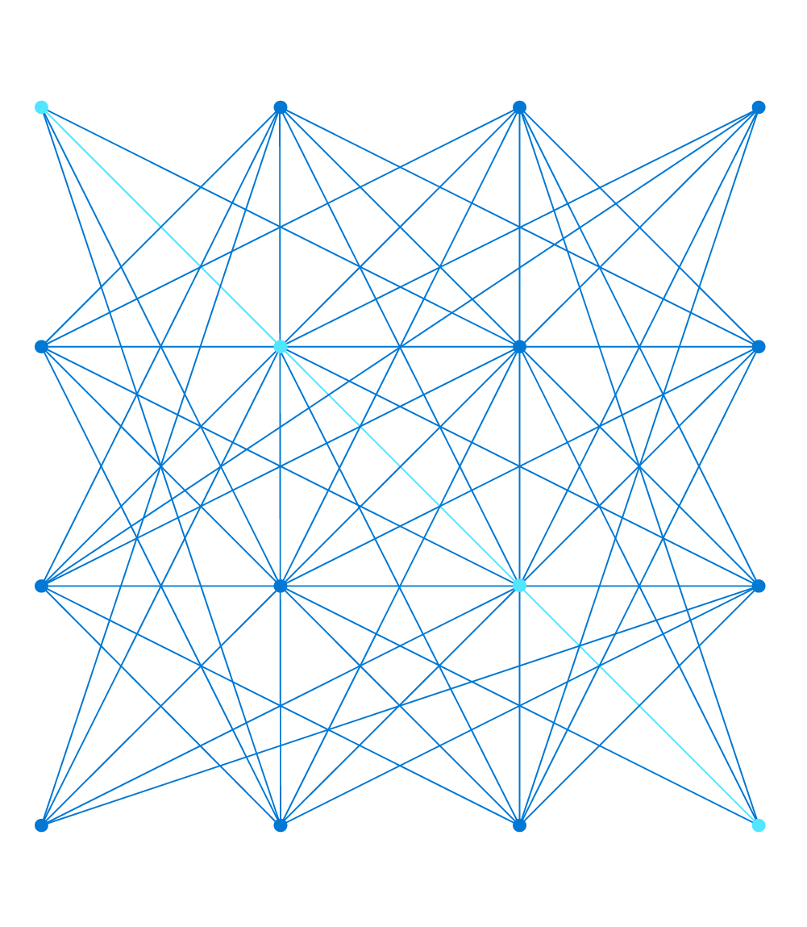
AZ-303: Microsoft Azure Architect Technologies
Presenter, MCT

Slide 2
Module 1: Module 1: Implement Virtual Networking
Virtual networks and virtual network peering

Slide 3
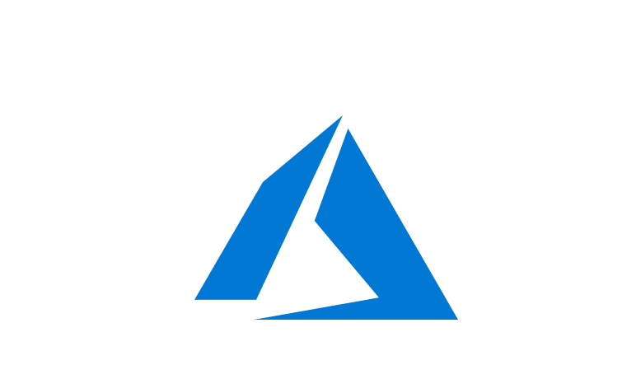
Learning Objectives
You will learn the following concepts:
Virtual Networking
Virtual network Peering
Implement VNet Peering

Slide 4
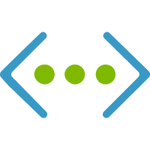
Virtual Networking

Slide 5
Azure Virtual Networking (1 of 3)
Virtual network concepts:
Address space
Subnets
Regions
Subscription
Best practices:
Ensure non-overlapping address spaces
Don’t cover the entire VNet address space
Configure a few larger VNets (rather than many small ones)
Secure VNets by assigning NSGs to subnets

Slide 6
Azure Virtual Networking (2 of 3)
Communicate with the Internet:
Outbound traffic is allowed by default
Inbound traffic can be provided via:
A public IP address
A public load balancer
Communicate between Azure resources:
Through a virtual network
Through a virtual network service endpoint and/or private endpoint
Through VNet Peering
Communicate with on-premises resources:
Point-to-site VPN
Site-to-site VPN
Azure ExpressRoute

Slide 7
Azure Virtual Networking (3 of 3)
Filter network traffic:
Network Security groups
Network virtual appliances
Route network traffic:
Route tables
BGP routes
Virtual network integration for Azure services:
Deploy dedicated instances of the service into a VNet
Use Private Link
Use service endpoints

Slide 8
Comparison of Virtual Network Peering and VPN Gateways (1 of 2)
Virtual Network peering and VPN gateways support connecting:
Virtual networks in different regions
Virtual networks in different Azure Active Directory tenants
Virtual networks in different Azure subscriptions
Virtual networks that use a mix of Azure deployment models

Slide 9
Comparison of Virtual Network Peering and VPN Gateways (2 of 2)
Item | Virtual network peering | VPN Gateway
Limits | Up to 500 per VNet | One per VNet (per gateway limits are SKU-dependent)
Pricing model | Ingress/Egress | Hourly + Egress
Encryption | Not included | IPsec/IKE
Bandwidth | No limits | SKU-dependent
Public endpoints | No | Yes
Transitivity | No | Yes (routing dependent)
Initial setup time | Fast | ~30 minutes
Typical scenarios | Data replication, database failover, and other scenarios needing frequent backups of large data. | Encryption-specific scenarios that are not latency sensitive and do not need high throughout.

Slide 10
Choose Between Virtual Network Peering and VPN Gateways
Virtual Network peering:
Direct (no interconnecting devices)
Low-latency, high-bandwidth
Regional or global
VPN gateways:
Serve as interconnecting devices
Introduce extra latency and limit bandwidth
Gateway transit:
Allows sharing a VPN or ExpressRoute gateway across a peering
Minimizes complexity and centralizes management

Slide 11
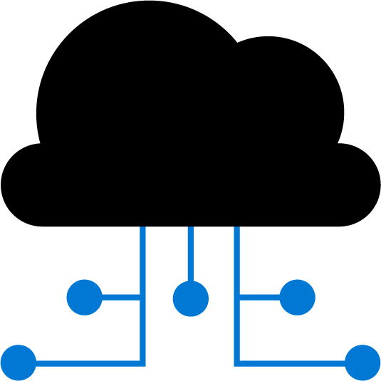
Virtual Network Peering

Slide 12
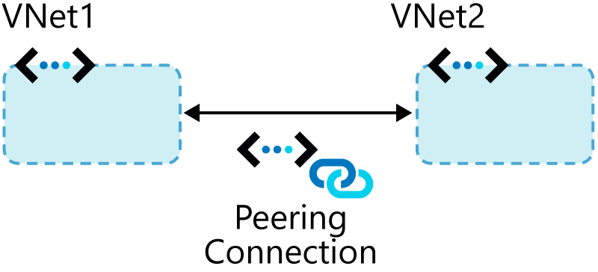
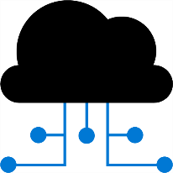
Connect Services with Virtual Network Peering (1 of 2)

Slide 13
Connect Services with Virtual Network Peering (2 of 2)
Types of peering connections:
Virtual network peering
Global virtual network peering
Peering considerations:
Reciprocal connections are required
Cross-subscription peerings are supported

Slide 14
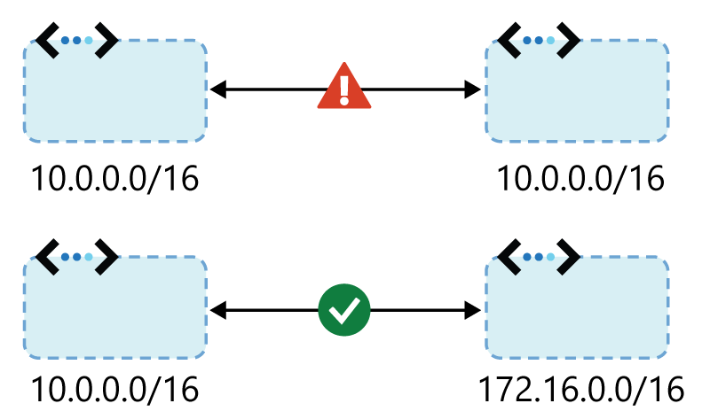
Transitivity and Gateway Transit
Virtual network peering is nontransitive
Gateway transit:
Facilitates cross-premises connectivity
Enable the Allow gateway transit option in the hub
Enable the Use remote gateways option on spoke
Peering considerations:
IP address spaces can’t overlap
Peering is the recommended option

Slide 15
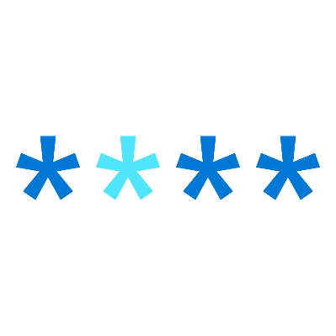
Implement VNet Peering

Slide 16
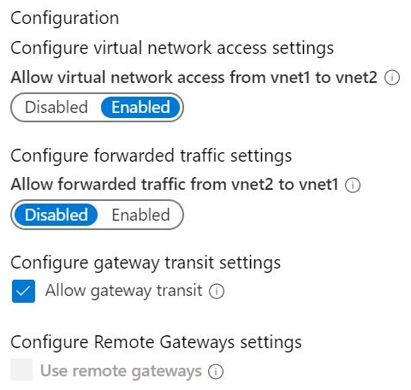
Configure VNet Peering
Configure VNet peering:
Create two virtual networks
Peer the virtual networks
Create virtual machines on each network
Test communication between the machines
Use the Add peering blade to configure peering:
Allow forwarded traffic
Allow gateway transit
Use remote gateways

Slide 17
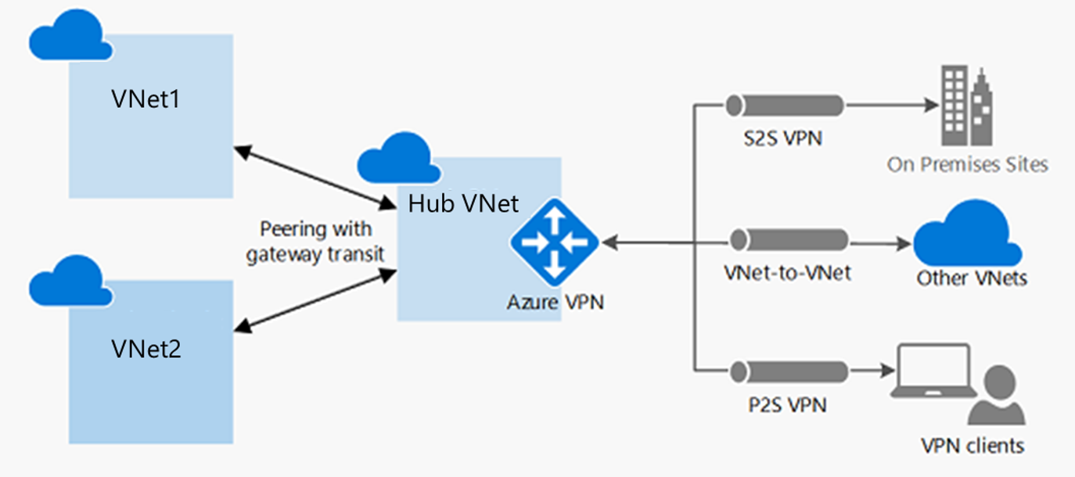
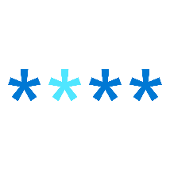
Service Chaining (1 of 2)
Hub and spoke architecture

Slide 18
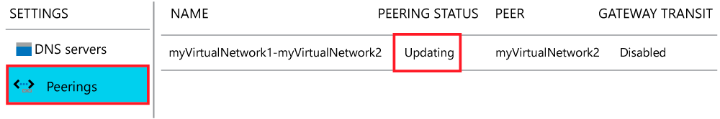
Service Chaining (2 of 2)
User defined routes and service chaining
Checking connectivity status:
Updating
Connected

Slide 19
Demonstration: VNet Peering
Configure VNet peering
Configure a VPN gateway
Allow gateway transit
Confirm VNet peering

Slide 20
Modify or Delete VNet Peering
Modify a peering:
In the Azure portal, list the existing virtual networks
Select the virtual network you want to change
Under Settings, select Peerings
Select the peering you want to change
Change the appropriate setting
Select Save
Delete a peering:
In the Azure portal, list the existing virtual networks
Select the virtual network you want to delete a peering for
Under Settings, select Peerings
On the peering blade, select Delete and then Yes

Slide 21
Requirements and Constraints
Peering virtual networks in different regions is also referred to as Global VNet Peering.
You can use remote gateways or allow gateway transit in globally peered virtual networks and locally peered virtual networks.
You can't add address ranges to, or delete address ranges from, a virtual network's address space once a virtual network is peered with another virtual network.
To add or remove address ranges, delete the peering, add or remove the address ranges, then re-create the peering.
You can peer two virtual networks deployed through Resource Manager or a virtual network deployed through Resource Manager with a virtual network deployed through the classic deployment model.
You cannot peer two virtual networks created through the classic deployment model

Slide 22

Module 1 Review Questions

Slide 23
Online Role-based training resources: Microsoft Learn https://docs.microsoft.com/en-us/learn/

Slide 24
Thank you.

